Slide 1
Computer Architecture & Networks
CHAPTER 1 (Part B):
NUMBER SYSTEMS

Slide 2
Learning Outcome
This chapter discusses about number systems.
To understand the conversion of number systems in computational methods.
Decimal
Binary
Hexadecimal
Octal
Number conversion
Binary Coded Decimal

Slide 3
NUMBER SYSTEMS
A set of values used to represent different quantities is known as Number System.
A number system can be used to represent the number of students in a class or number of presenters in a session and etc.
The digital computer represents all kind of data and information in binary numbers.
It includes audio, graphics, video, text and numbers.
The total number of digits used in a number system is called its base or radix.
System | Base | Symbols
Decimal | 10 | 0, 1, … 9
Binary | 2 | 0, 1
Octal | 8 | 0, 1, 2, …7
Hexa-decimal | 16 | 0, 1, … 9, A, B, ... F

Slide 4
Decimal Numbers
The base or radix of decimal numbers is 10, because only ten symbols (0 through 9) are used.
The column weights of decimal numbers are powers of ten that increase from right to left
10² 10¹ 10⁰. 10⁻¹ 10⁻² 10⁻³ 10⁻⁴ …
Example 1: 853 is a decimal number
853₁₀ = (8×10²) + (5×10¹) + (3×10⁰)
Example 2: 9781.024 is a decimal number
9781.024₁₀ = (9x10³) + (7x10²) + (8x10¹) + (1x10⁰) +
(0x10⁻¹) + (2x10⁻²) + (4x10⁻³)

Slide 5
Decimal Numbers
The value of a number is calculated by multiplying each digit by its weight, then add up the totals.
Digit
1024.57
Weight 1000 100 10 1 0.1 0.01
Value 1000 + 0 + 20 + 4 . 0.5 + 0.07

Slide 6
Decimal System
Test Yourself:
Express the decimal number 2745.214 as a sum of the values of each digit.

Slide 7
Decimal System
weights
10³
10²
10¹
10⁰
10⁻¹
10⁻²
10⁻³
2
7
4
5
.
2
1
4
2745.214₁₀
= (2x10³)+(7x10²)+(4x10¹)+(5x10⁰)+(2x10⁻¹)+(1x10⁻²)+(4x10⁻³)
= (2x1000)+(7x100)+(4x10)+(5x1)+(2x0.1)+(1x0.01)+(4x0.001)
= (2000)+(700)+(40)+(5)+(0.2)+(0.01)+(0.004)

Slide 8
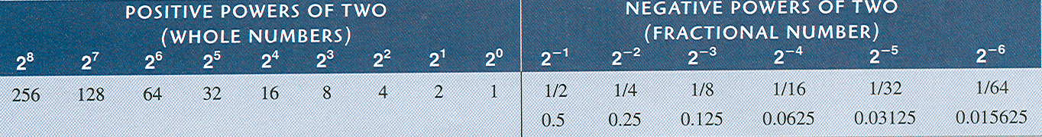
Binary Numbers
For digital systems, the binary number system is used.
Binary has a radix of 2 and uses the digits 0 and 1 to represent quantities.
The column weights of binary numbers are powers of two that increase from right to left.
2² 2¹ 2⁰. 2⁻¹ 2⁻² 2⁻³ 2⁻⁴ …
Example 1:
1011₂ = (1×2³) + (0×2²) + (1×2¹) + (1×2⁰)
Example 2: 1101.01₂
=((1x2³) + (1x2²) + (0x2¹) + (1x2⁰) + (0x2⁻¹) + (1x2⁻²))₁₀
=((1x8) + (1x4) + (0x2) + (1x1) + (0x0.5) + (1x0.25))₁₀
= ( 8 + 4 + 0 + 1 + 0 + 0.25 )₁₀
= 13.25₁₀

Slide 9
Binary-to-Decimal Conversion
The value of a number is calculated by multiplying each digit by its weight, then add up the totals.
Digit
1011.101
Weight 8 4 2 1 0.5 0.25 0.125
Value 8 + 0 + 2 + 1 . 0.5 + 0 + 0.125
11.625

Slide 10
Example
Convert the binary number 10011.011₂ to decimal.

Slide 11
Example
Convert the binary number 10011.011₂ to decimal.
Solution
Note the subscript 2 clarifies the base of the number (binary).Write out the bits and their weights. Multiply the bit by its corresponding weight and record the result. At the end, add the results to get the decimal number.
Binary 1 0 0 1 1 . 0 1 1 Weights 16 8 4 2 1 . 0.5 0.25 0.125
--------------------------------------------------------------------- 16 + 0 + 0 + 2 + 1 + 0 + 0.25 + 0.125
Decimal 19.375

Slide 12
Decimal-to-Binary Conversion
Whole decimal numbers are converted into binary as follows:
135₁₀ from decimal into binary. Note the subscript 10 clarifies the base of the number (decimal).
128 + 4 + 2 + 1 = 135
MSB
LSB
128 | 64 | 32 | 16 | 8 | 4 | 2 | 1
1
0
0
0
0
1
1
1

Slide 13
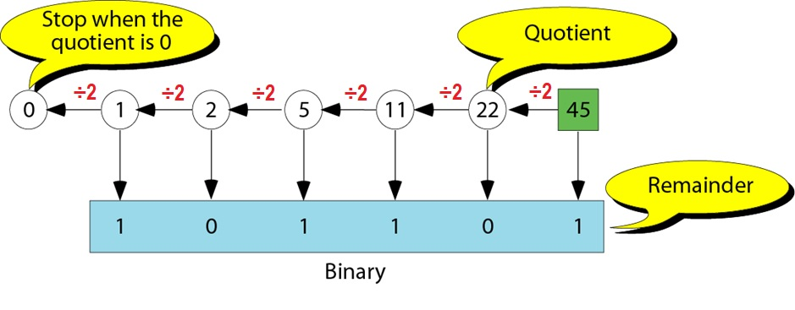
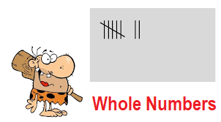
Decimal-to-Binary Conversion
Integer part: Divide by the base (2) and keep track of remainder

Slide 14
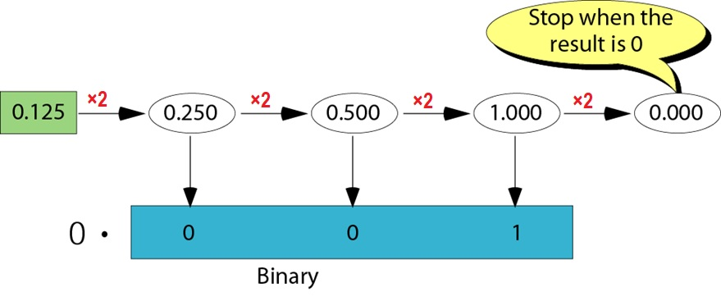
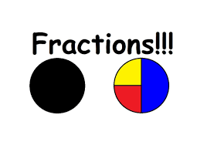
Decimal-to-Binary Conversion
Fractional part: Multiply by the base (2) and keep track of integer part

Slide 16
Example
Convert the decimal number 35.875 to binary.

Slide 17
Example
Convert the decimal number 35 to binary.
Solution
Write out the number at the right corner. Divide the number continuously by 2 and write the quotient and the remainder. The quotients move to the left, and the remainder is recorded under each quotient. Stop when the quotient is zero.
0 ⬅ 1 ⬅ 2 ⬅ 4 ⬅ 8 ⬅ 17 ⬅ 35 Dec.
Binary 1 0 0 0 1 1

Slide 18
Example
Convert the fraction 0.875 to binary
Solution
Write the fraction at the left corner. Multiply the number continuously by 2 and extract the integer part as the binary digit. Stop when the number is 0.0.
0.875 ➔ 1.750 ➔ 1.5 ➔ 1.0 ➔ 0.0
0 . 1 1 1
Thus, the final solution is:
35.875 = 100011.111

Slide 19
Binary Numbers
It is difficult to read long strings of binary numbers-- and even a modestly-sized decimal number becomes a very long binary number.
For example: 11010100011011₂ = 13595₁₀
For compactness and ease of reading, binary values are usually expressed using the hexadecimal, or base-16, numbering system.

Slide 20
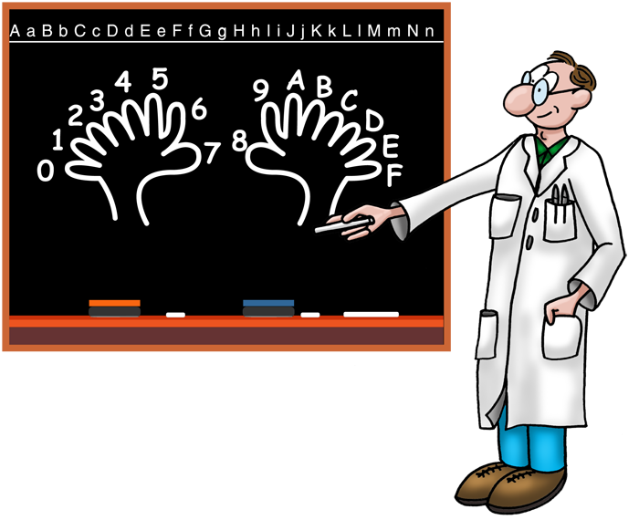
Hexadecimal Numbers

Slide 21
Hexadecimal Numbers
Hexadecimal uses sixteen characters to represent numbers: the numbers 0 through 9 and the alphabetic characters A through F. All modern computing platforms use 32-, or 64-bit words
Decimal
Hexadecimal
Binary
0 1 2 3 4 5 6 7 8 9 10 11 12 13 1415
16
0 1 2 3 4 5 6 7 8 9 A B C D E F
10
0000
0001
0010
0011
0100
0101
0110
0111
1000
1001
1010
1011
1100
1101
1110
1111
0001 0000
Large binary number can easily be converted to hexadecimal by grouping 4 bits at a time and writing the equivalent hexadecimal character.
Example
Express 1001 0110 0000 1110₂ in hexadecimal:
Solution
Group the binary number by 4-bits starting from the right. Thus, 960E

Slide 22
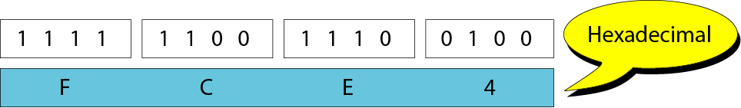
Hexadecimal ↔ Binary
A 4-bit binary number can be represented by a hexadecimal digit, and vice versa.
Binary ------------
0000
0001
0010
0011
0100
0101
0110
0111
Hex Digit ------------
0
1
2
3
4
5
6
7
Binary ------------
1000
1001
1010
1011
1100
1101
1110
1111
Hex Digit ------------
8
9
A
B
C
D
E
F

Slide 23
Example
Convert the following binary number to hexadecimal 11010101000.1111010111

Slide 24
Example
Convert the following binary number to hexadecimal 11010101000.1111010111
Solution
For the integer part, group each 4 bits starting from the first bit to the right of the binary point (LSB) and add any required number of zeros to the left. For the fraction part, group each 4 bits starting from the first bit to the left of the binary point and add any required number of zeros to the right.
( 0110 1010 1000 . 1111 0101 1100 )₂
( 6 A 8 . F 5 C )₁₆

Slide 25
Hexadecimal ↔ Decimal
Hexadecimal is a weighted number system. The column weights are powers of 16, which increase from right to left.
Decimal
Hexadecimal
Binary
0 1 2 3 4 5 6 7 8 9 10 11 12 13 1415
16
0 1 2 3 4 5 6 7 8 9 A B C D E F
10
0000
0001
0010
0011
0100
0101
0110
0111
1000
1001
1010
1011
1100
1101
1110
1111
0001 0000
{
16³ 16² 16¹ 16⁰
Digit weights
4096 256 16 1
Example
Express 1A2F₁₆ in decimal.
Solution
Start by writing the column weights:
4096 256 16 1
1 A 2 F₁₆
1(4096) + 10(256) +2(16) +15(1) =
6703₁₀

Slide 27
Octal Numbers
Decimal
Octal
Binary
Octal uses eight characters the numbers 0 through 7 to represent numbers. It was widely used in computing systems such as IBM mainframes employed 12-bit, 24-bit or 36-bit words. It is still used in file permissions under Unix systems.
0 1 2 3 4 5 6 7 8 9 10 11 12 13 1415
16
0 1 2 3 4 5 6 7 10 11 12 13 14 15 16 17
20
000
001
010
011
100
101
110
111
001 000
001 001
001 010
001 011
001 100
001 101
001 110
001 111
010 000
Binary number can easily be converted to octal by grouping bits 3 at a time and writing the equivalent octal character for each group.
Example
Express 1 001 011 000 001 110₂ in octal:
Solution
Group the binary number by 3-bits starting from the right. Thus, 113016₈

Slide 28
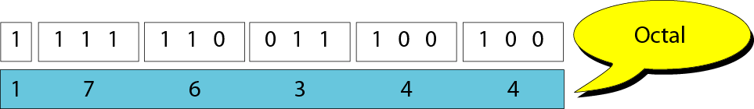
Octal ↔ Binary Conversion
A 3-bit binary number can be represented by an octal digit, and vice versa.
Binary ------------
000
001
010
011
Oct Digit ------------
0
1
2
3
Binary ------------
100
101
110
111
Oct Digit ------------
4
5
6
7

Slide 29
Example
Convert the following binary number to octal 11010101000.1111010111

Slide 30
Example
Convert the following binary number to octal 11010101000.1111010111
Solution
For the integer part, group each 3 bits starting from the first bit to the right of the binary point (LSB) and add any required number of zeros to the left. For the fraction part, group each 3 bits starting from the first bit to the left of the binary point and add any required number of zeros to the right.
(011 010 101 000 . 111 101 011 100)₂
( 3 2 5 0 . 7 5 3 4 )₈

Slide 31
Octal ↔ Decimal
Decimal
Octal
Binary
Octal is also a weighted number system. The column weights are powers of 8, which increase from right to left.
0 1 2 3 4 5 6 7 8 9 10 11 12 13 1415
16
0 1 2 3 4 5 6 7 10 11 12 13 14 15 16 17
20
000
001
010
011
100
101
110
111
001 000
001 001
001 010
001 011
001 100
001 101
001 110
001 111
010 000
{
8³ 8² 8¹ 8⁰
Digit weights
512 64 8 1
Example
Express 3702₈ in decimal.
Solution
Start by writing the column weights:
512 64 8 1
3 7 0 2₈
1986₁₀
3(512) + 7(64) +0(8) +2(1) =

Slide 32
Example
Convert the binary number 11010100011011 to hexadecimal and octal numbers.

Slide 33
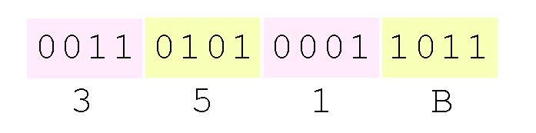
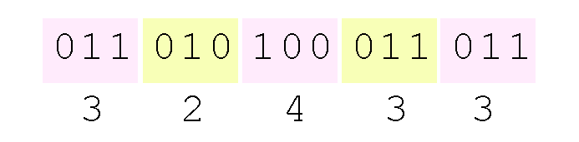
Example
Convert the binary number 11010100011011 to hexadecimal and octal numbers.
Solution
Using groups of four bits, the binary number 11010100011011₂ (= 13595₁₀) in hexadecimal is:
Octal (base 8) values are derived from binary by using groups of three bits:

Slide 34
Octal ↔ Hex
Go through Binary/Decimal
Hex → Binary /Decimal → Octal
Octal → Binary /Decimal → Hex

Slide 35
Summary of Number System Conversions
Binary
Decimal
Octal
Hexadecimal
Binary ⇨ Decimal (sum of all base 2 weighting)
Binary ⇨ Hexadecimal (4 bits grouping)
Binary ⇨ Octal (3 bits grouping)
Decimal ⇨ Binary (divide by 2)
Decimal ⇨ Hexadecimal (divide by 16)
Decimal ⇨ Octal (divide by 8)
Hexadecimal ⇨ Binary (equivalent 4 bits of each hexadecimal digit)
Hexadecimal ⇨ Decimal (sum of all base 16 weighting)
Octal ⇨ Binary (equivalent 3 bits of each digit)
Octal ⇨ Decimal (sum of all base 8 weighting)

Slide 36
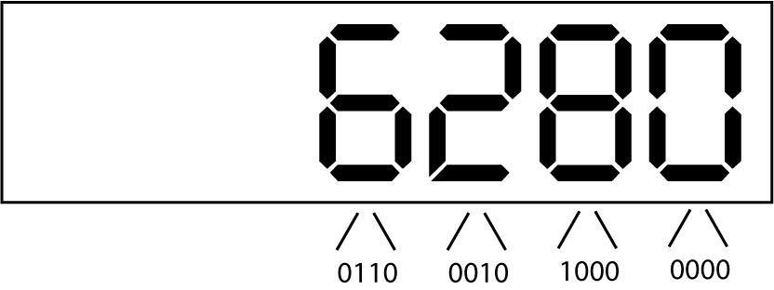
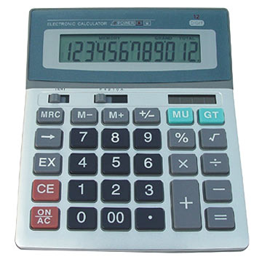
Binary-Coded Decimal
BCD enables fast conversions from decimal to binary for applications such as pocket calculators.
Each digit on a calculator corresponds directly to a four-bit block in BCD.

Slide 37
Binary Coded Decimal (BCD)
BCD represents decimal numbers using blocks of four binary digits.
Each block of four is converted and the decimal values are then read off:
Therefore 1001 0011 1000 in BCD = 938 in denary.
8 | 4 | 2 | 1
1 | 0 | 0 | 1
8 + 0 + 0 + 1
9
8 | 4 | 2 | 1
0 | 0 | 1 | 1
0 + 0 + 2 + 1
3
8 | 4 | 2 | 1
1 | 0 | 0 | 0
8 + 0 + 0 + 0
8

Slide 38
Binary-Coded Decimal
To code a number with n decimal digits, we need 4n bits in BCD
e.g. (365)₁₀ = (0011 0110 0101)_{BCD}
This is different to converting to binary, which is (365)₁₀ = (101101101)₂
Clearly, BCD requires more bits. BUT it is easier to understand/interpret

Slide 39
Binary-Coded Decimal
Decimal
Binary
BCD
0 1 2 3 4 5 6 7 8 9 10 11 12 13 1415
0000 0001 0010 0011 0100 0101 0110 0111 1000 1001 1010 1011 1100 1101 1110 1111
0000 0001 0010 0011 0100 0101 0110 0111 1000 1001 0000 0001 0010 0011 0100 0101
The table illustrates the difference between straight binary and BCD. BCD represents each decimal digit with a 4-bit code.
Notice that the codes 1010 through 1111 are not used in BCD.
0001 0001 0001 0001 0001 0001

Slide 40
BINARY ADDITION
The rules for binary addition are
0 + 0 = 0 Sum = 0, carry = 0
0 + 1 = 0 Sum = 1, carry = 0
1 + 0 = 0 Sum = 1, carry = 0
1 + 1 = 10 Sum = 0, carry = 1
When an input carry = 1 due to a previous result, the rules are
1 + 0 + 0 = 01 Sum = 1, carry = 0
1 + 0 + 1 = 10 Sum = 0, carry = 1
1 + 1 + 0 = 10 Sum = 0, carry = 1
1 + 1 + 1 = 10 Sum = 1, carry = 1

Slide 41
BINARY SUBTRACTION
The rules for binary subtraction are
0 − 0 = 0
1 − 1 = 0
1 − 0 = 1
10 − 1 = 1 with a borrow of 1

Slide 43
Binary Multiplication

Slide 44
BINARY ADDITION – SELF TEST 1
11011 + 1001010 =
1011001 + 111010 =

Slide 45
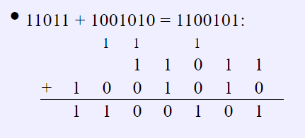
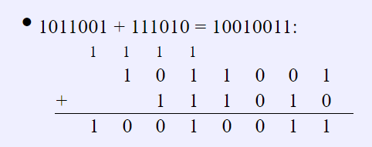

Slide 46
BINARY SUBTRACTION – SELF TEST 2
1000101 - 101100 =
1110110 - 1010111 =

Slide 47
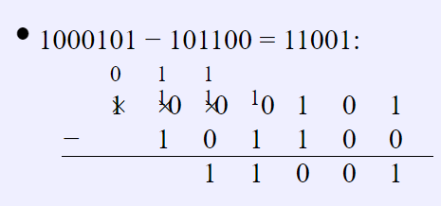
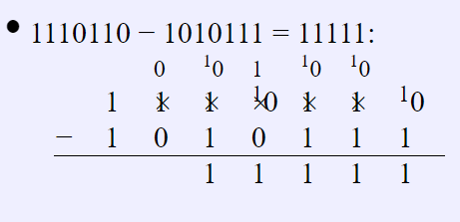

Slide 48
END

